Slide 1
Queues

Slide 2
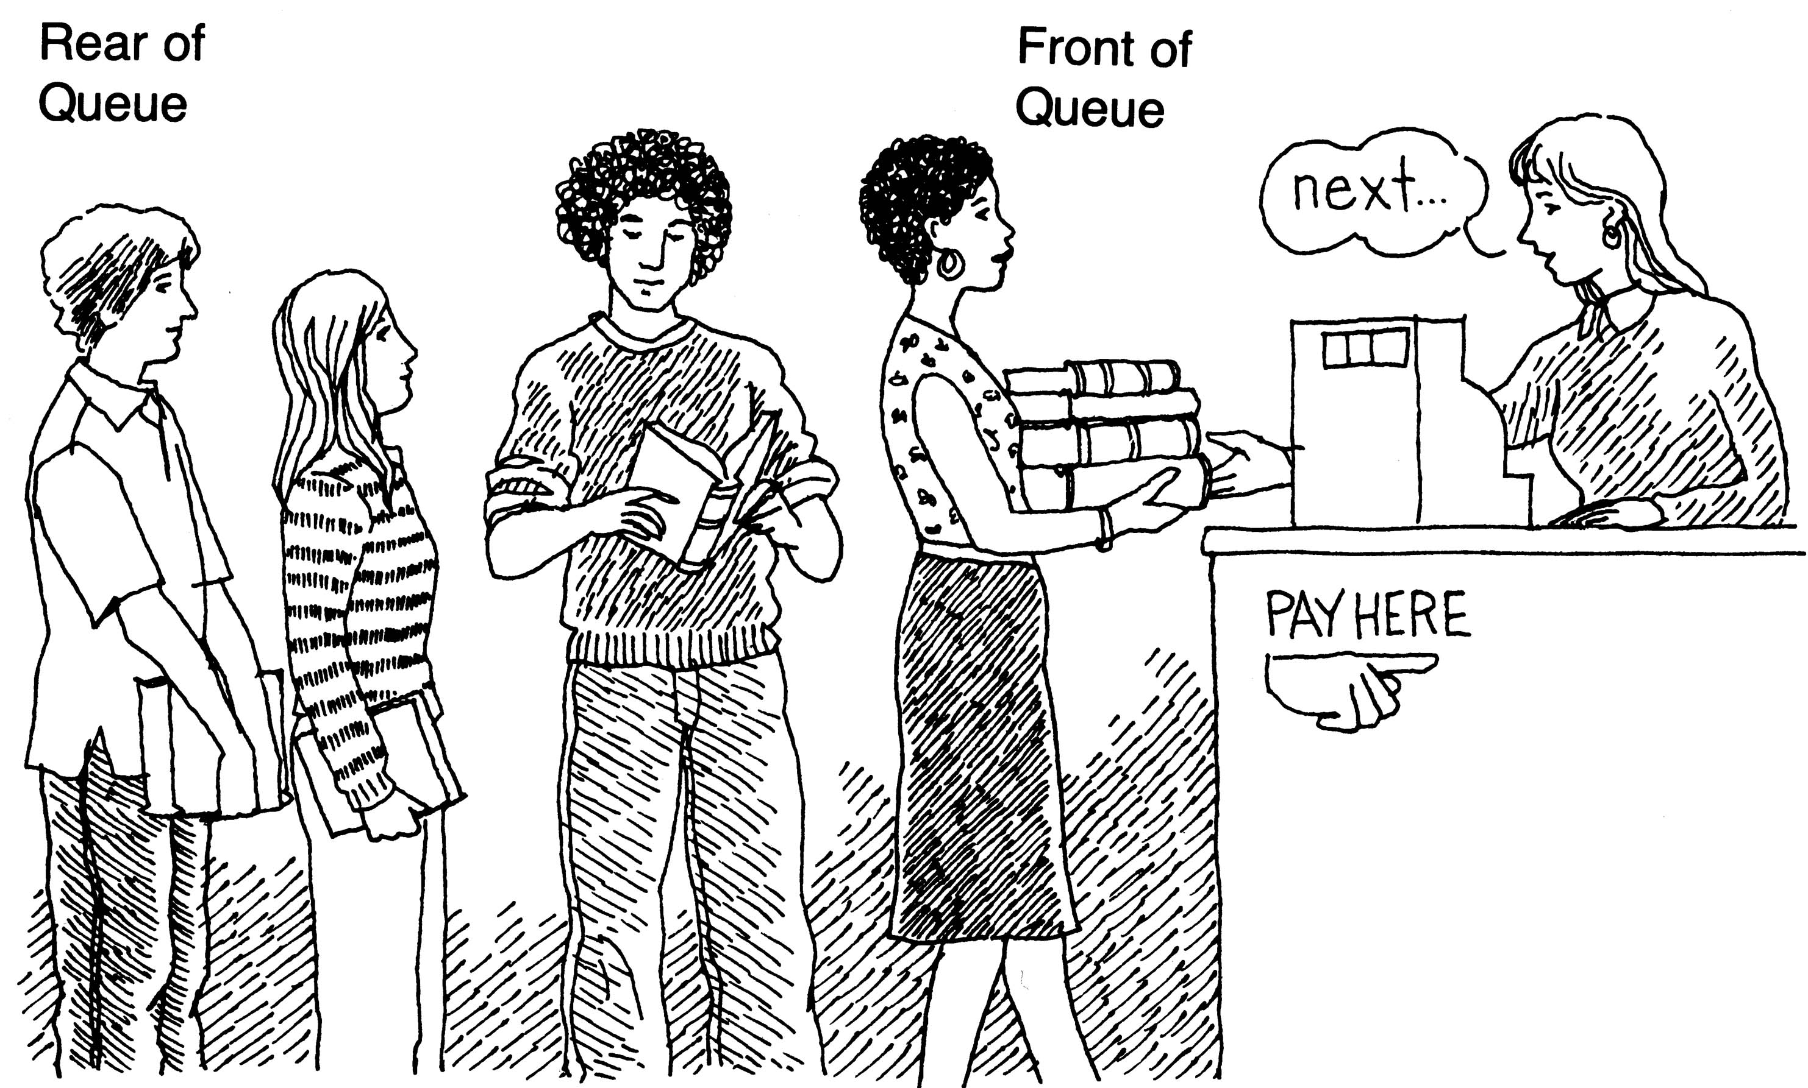
What is Queue?
It is an ordered group of homogeneous items
Queues have two ends:
Elements are added at one end
Elements are removed from the other end
The element added first is also removed first (FIFO: First In, First Out)

Slide 3
Queue Operations
Enqueue(): Inserting an element into queue
Dequeue(): Deleting an element from the queue
Isfull(): Check if the queue is full or not
IsEmpty(): Check if the queue is empty or not
Display(): Display the contents of the queue

Slide 4
Types of Queues
Simple/Linear Queue
Circular Queue
Double ended queue
Priority Queue

Slide 5
Simple Queue - Enqueue
Function: Adds new item/element into the queue through rear of the queue
Precondition: Queue has been initialized and is not full
Post condition: Newly inserted element is at the rear of the queue
Full condition: rear == (MAX -1)

Slide 6
Simple Queue - Dequeue
Function: Removes front element from the queue and display or remove element and return
Precondition: Queue has been initialized and is not empty
Post condition: front element has been removed from the queue and display the removed element
Empty condition: front > rear

Slide 7
Limitation of simple queue
Wastage of space – arrays
How to overcome?
Shift the elements towards index zero every time an element is deleted from the queue
Use Circular Queue

Slide 8
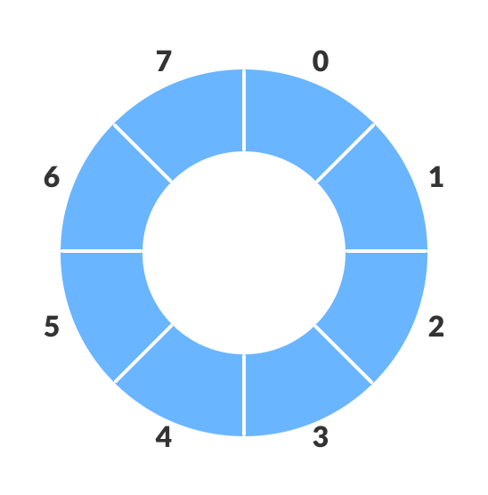
Circular Queue
Overcomes the limitations of simple queue
Circular Queue works by the process of circular increment i.e., when we try to increment the pointer and we reach the end of the queue, we start from the beginning of the queue

Slide 9
How Circular Queue Works?
The circular queue work as follows:
two pointers FRONT and REAR
FRONT: track the first element of the queue
REAR: track the last elements of the queue
initially, set value of FRONT and REAR to -1

Slide 10
Circular queue - Enqueue
Check if the queue is full
For the first element, set value of FRONT to 0
Circularly increase the REAR index by 1 (i.e. if the rear reaches the end, next it would be at the start of the queue)
Add the new element in the position pointed to by REAR
REAR is calculated with REAR = (REAR + 1) % Q_SIZE
Full Case:
Case 1: FRONT = 0 && REAR == SIZE – 1
Case 2: REAR = FRONT - 1

Slide 11
Circular Queue - Dequeue
Check if the queue is empty
Return the value pointed by FRONT
Circularly increase the FRONT index by 1
For the last element, reset the values of FRONT and REAR to -1
FRONT is calculated with FRONT = (FRONT + 1) % Q_SIZE
Empty Case:
FRONT == REAR

Slide 12
Other Types of Queues
Double Ended Queue: is a type of queue in which insertion and removal of elements can either be performed from the front or the rear.
It does not follow FIFO rule.
Two Types: Input restricted and Output Restricted
Priority Queue: A priority queue is a special type of queue in which each element is associated with a priority value
An element with high priority is dequeued before an element with low priority.
If two elements have the same priority, they are served according to their order in the queue.

